Slide 2
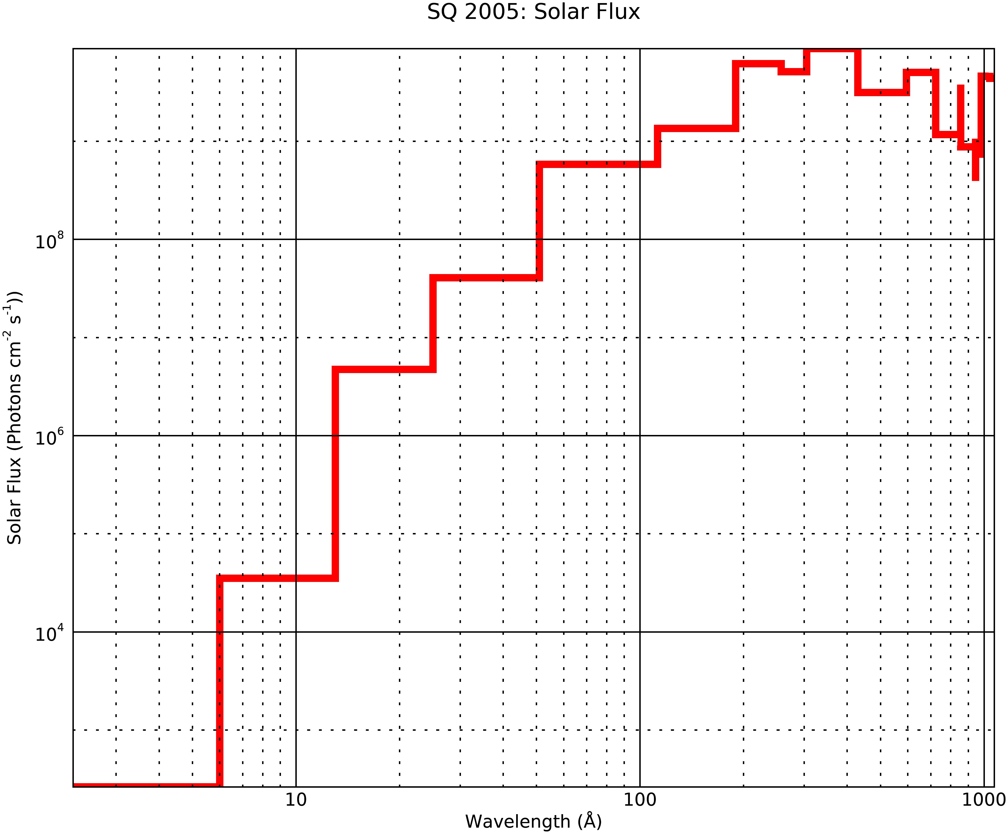
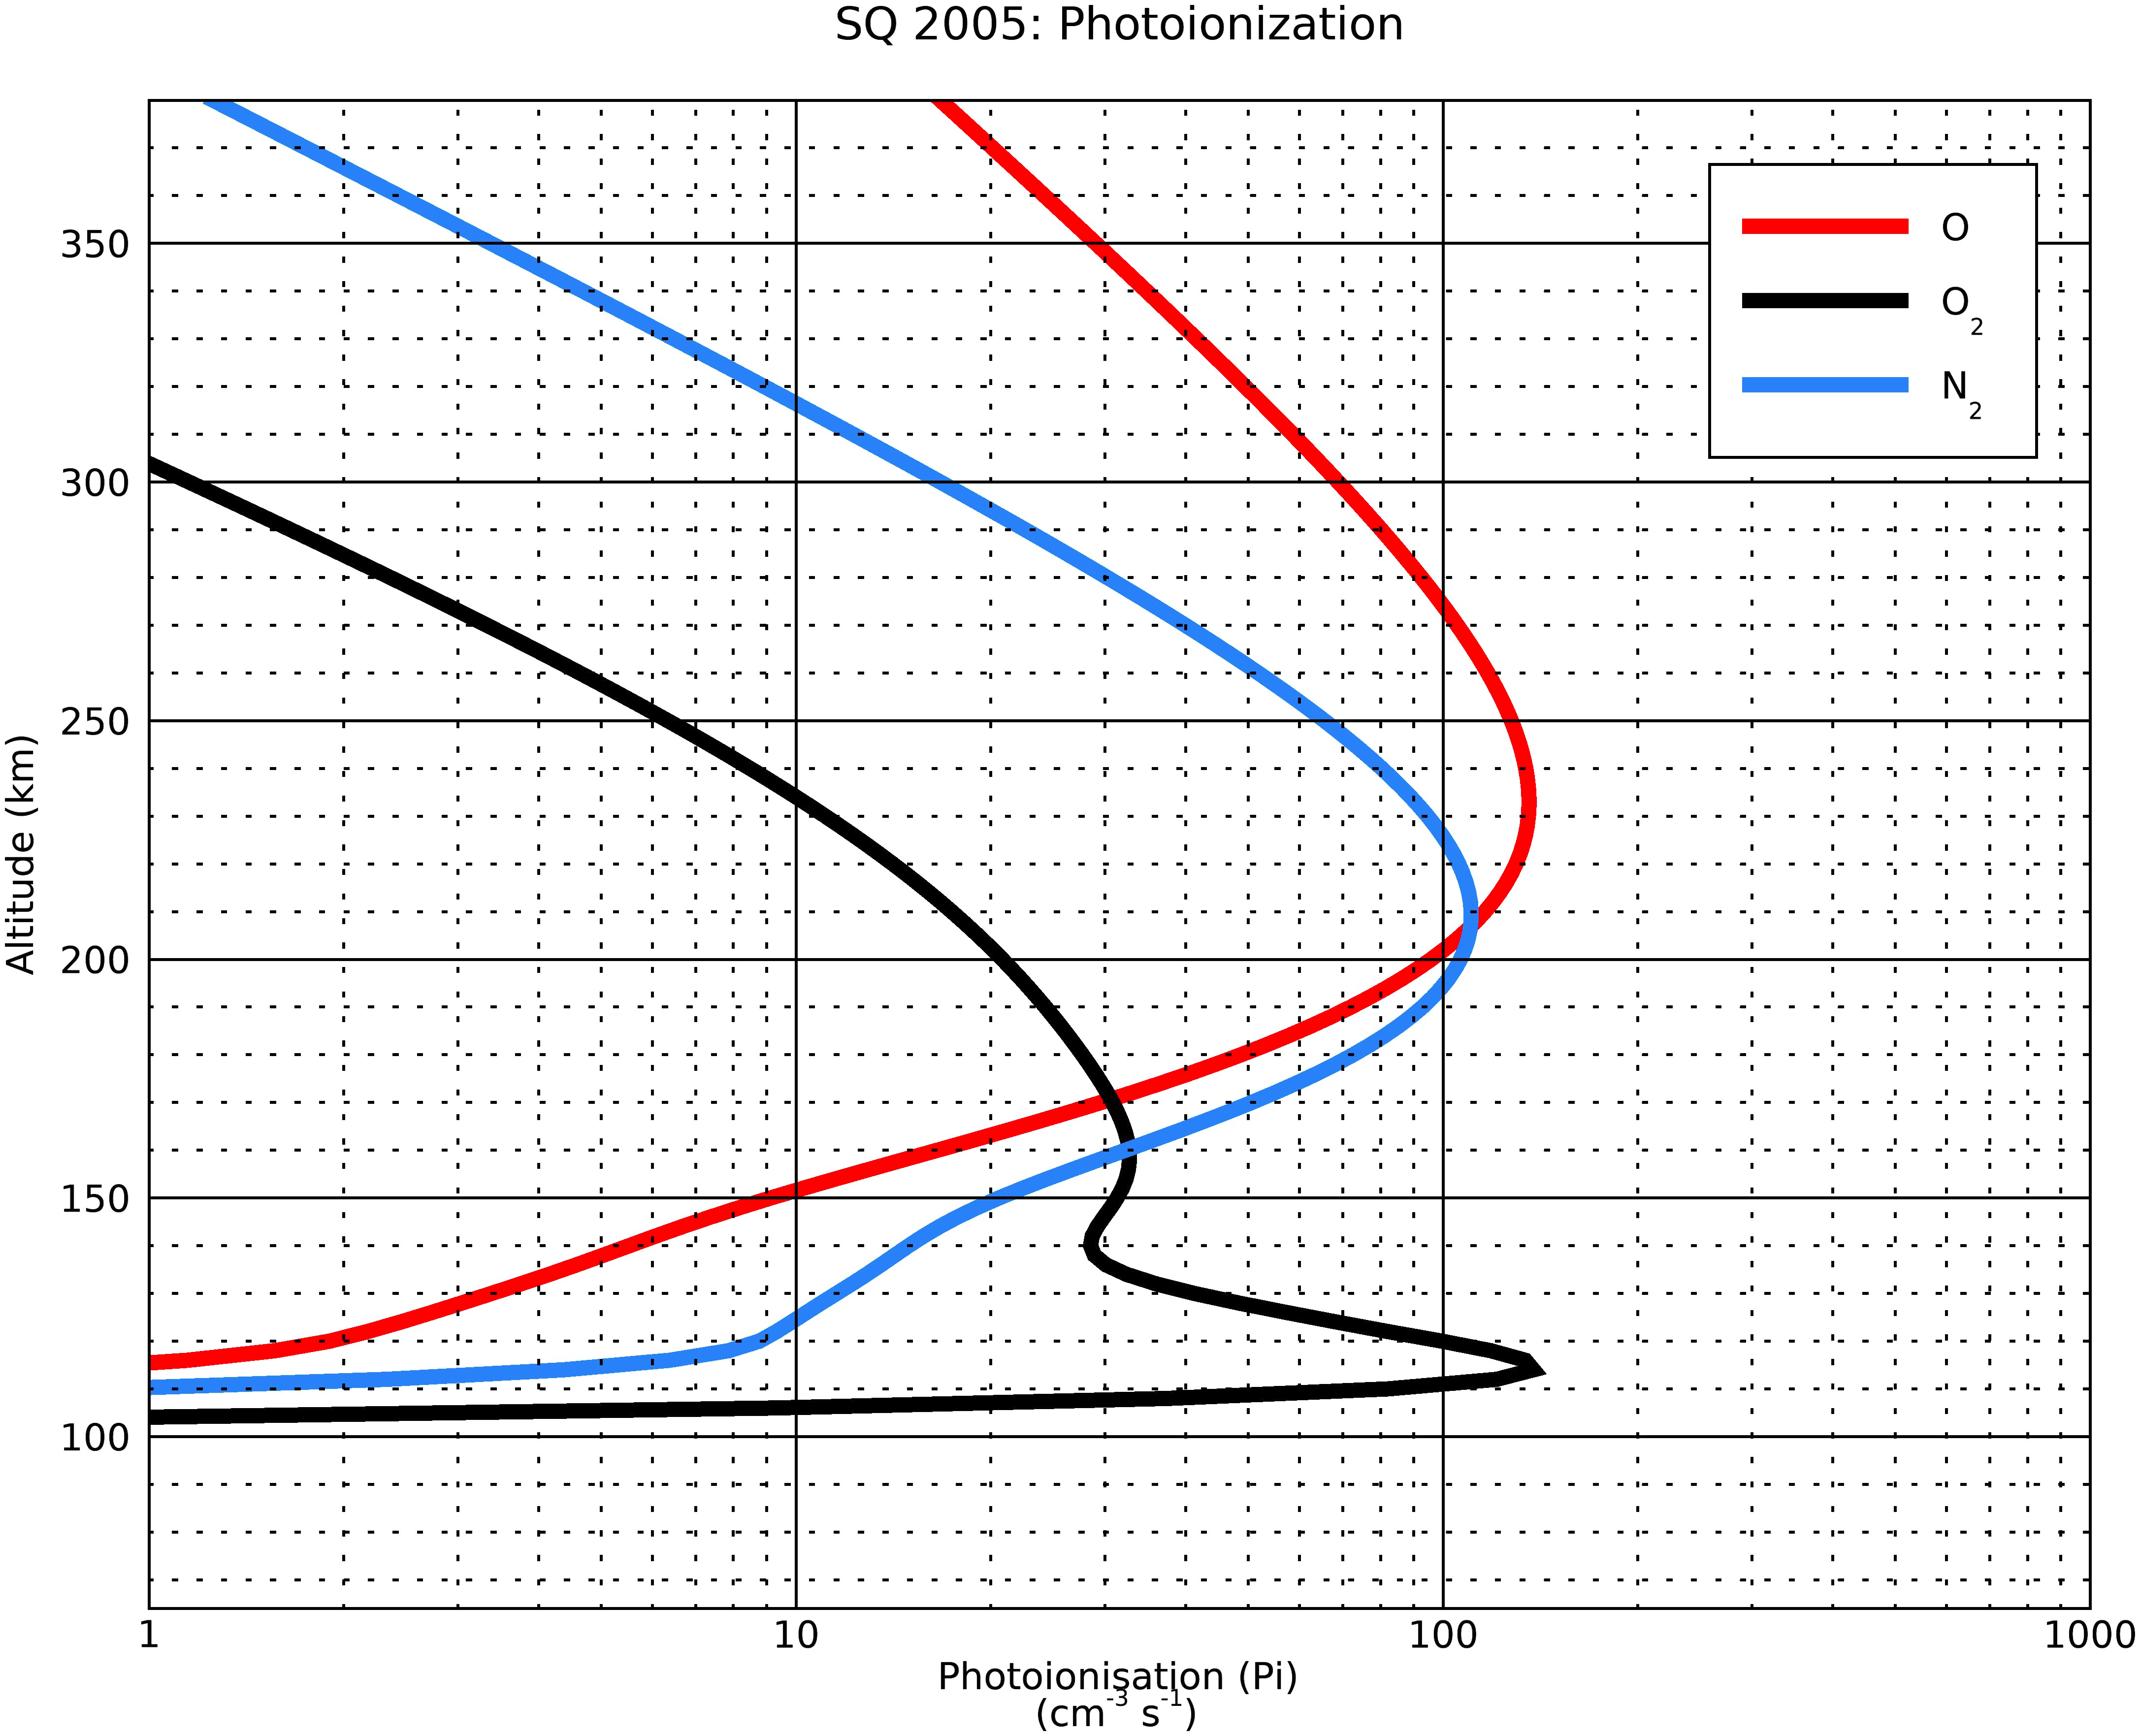
Electron Density and Electron Temperature Comparisons Results
ACE_PE report Srimoyee Samaddar
5/17/20

Slide 3
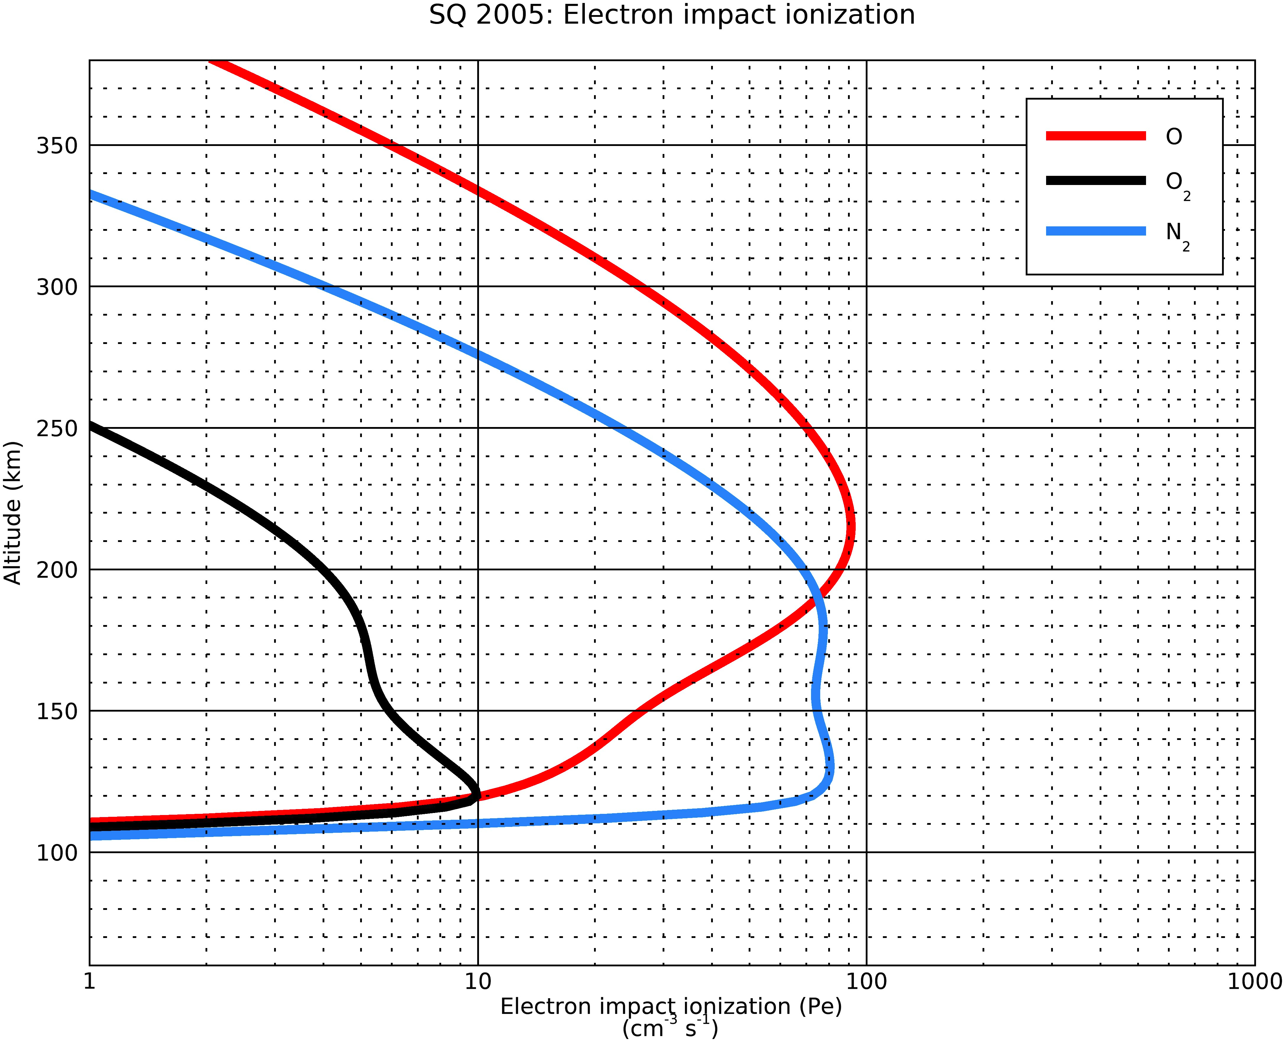
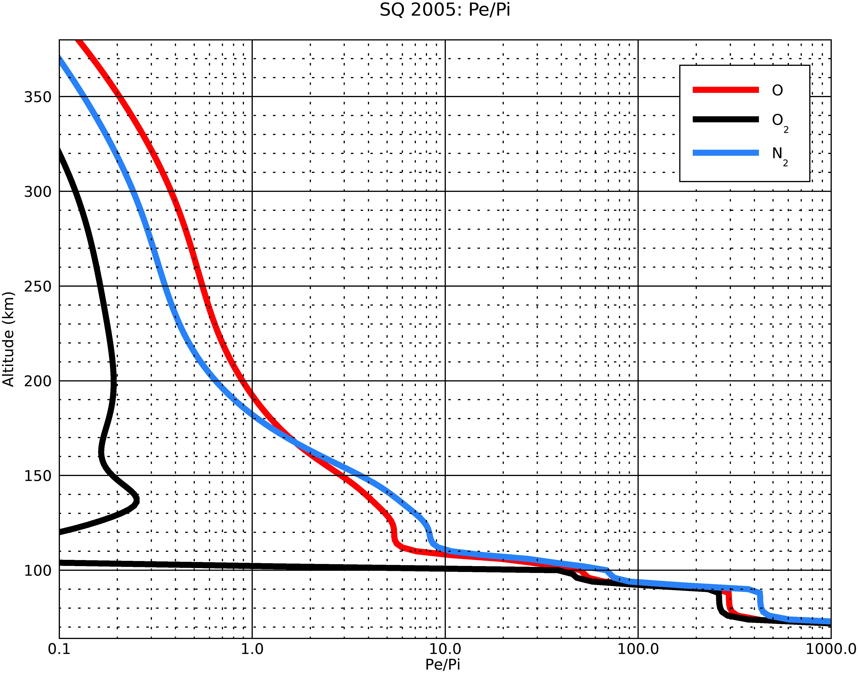
Electron Density and Electron Temperature Comparisons Results
ACE_PE report Srimoyee Samaddar
5/17/20

Slide 4
Comparisons of the pe/pi ratios of the IDL glow model, IDL glow model with IRI interface and SQ’05 paper results
O data
wave_lo | wave_hi | Model I (Org) pe/pi | SQ05 pe/pi (II) | Height | Model I/Model II
0.5 | 4 | 287.911 | 217.12 | 78 | 1.32604
4 | 8 | 50.4087 | 50.593 | 90 | 0.996356
8 | 18 | 24.6908 | 23.562 | 102 | 1.04791
18 | 32 | 73.4398 | 71.378 | 114 | 1.02889
32 | 70 | 5.07072 | 4.995 | 108 | 1.01516
70 | 155 | 2.26706 | 2.192 | 120 | 1.03424
155 | 224 | 1.15906 | 1.092 | 136 | 1.06141
224 | 290 | 0.78414 | 0.694 | 148 | 1.12989
290 | 320 | 0.506374 | 0.418 | 154 | 1.21142
320 | 540 | 0.155375 | 0.127 | 164 | 1.22343
540 | 650 | 0 | 0 | 170 | 0
ACE_PE report Srimoyee Samaddar
5/17/20

Slide 5
Comparisons of the pe/pi ratios of the IDL glow model, IDL glow model with IRI interface and SQ’05 paper results
O2 data
wave_lo | wave_hi | Model I Org) pe/pi | SQ05 pe/pi (II) | Height (Tau=1) | Model I/Model II
0.5 | 4 | 255.866 | 210.83 | 78 | 1.21361
4 | 8 | 43.7843 | 50.156 | 90 | 0.872962
8 | 18 | 21.4887 | 20.29 | 102 | 1.05908
18 | 32 | 63.7336 | 59.953 | 114 | 1.06306
32 | 70 | 4.28988 | 4.271 | 108 | 1.00442
70 | 155 | 1.6802 | 1.613 | 120 | 1.04166
155 | 224 | 0.621613 | 0.579 | 136 | 1.0736
224 | 290 | 0.277783 | 0.242 | 148 | 1.14786
290 | 320 | 0.135069 | 0.105 | 154 | 1.28637
320 | 540 | 0.0310659 | 0.024 | 164 | 1.29441
540 | 650 | 0 | 0 | 170 | 0
ACE_PE report Srimoyee Samaddar
5/17/20

Slide 6
Comparisons of the pe/pi ratios of the IDL glow model,
IDL glow model with IRI interface and SQ’05 paper results
N2 data
wave_lo | wave_hi | Model I (Org) pe/pi | SQ05 pe/pi (II) | Height (Tau =1) | Model I/Model II
0.5 | 4 | 417.762 | 342.66 | 78 | 1.21917
4 | 8 | 68.4776 | 80.88 | 90 | 0.846657
8 | 18 | 32.1722 | 32.126 | 102 | 1.00144
18 | 32 | 11.2645 | 10.834 | 114 | 1.03973
32 | 70 | 7.86467 | 7.789 | 108 | 1.00971
70 | 155 | 2.95828 | 2.859 | 120 | 1.03473
155 | 224 | 0.995094 | 0.933 | 136 | 1.06655
224 | 290 | 0.409681 | 0.361 | 148 | 1.13485
290 | 320 | 0.224721 | 0.178 | 154 | 1.26248
320 | 540 | 0.0398586 | 0.031 | 164 | 1.28576
540 | 650 | 0 | 0 | 170 | 0
ACE_PE report Srimoyee Samaddar
5/17/20

Slide 7
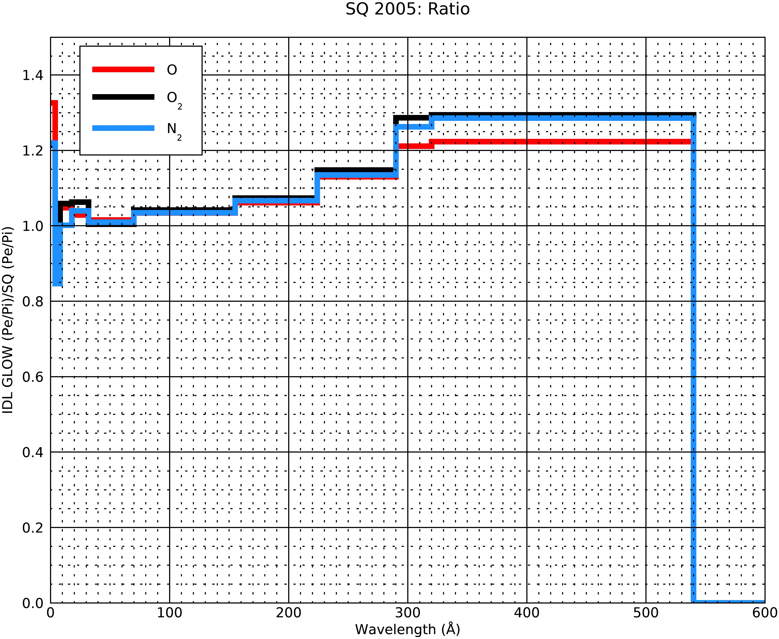
Error plots between IDL glow and SQ’05 pe/pi ratios data
ACE_PE report Srimoyee Samaddar
5/17/20

